Slide 1
Visual Design Principals
Design Evaluation 1
Milton Glaser
Web Development
Michelle McGinty

Slide 2
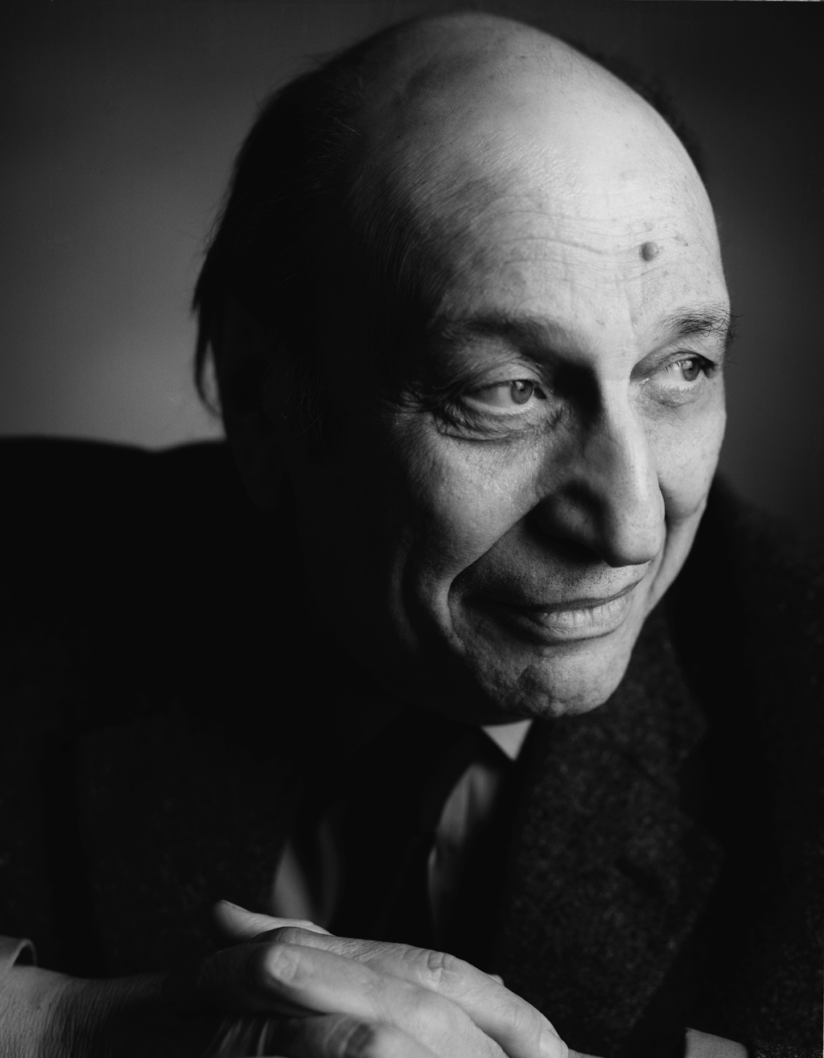
Milton Glaser
Background
Milton Glaser was born June 26, 1929, New York City and is an American graphic designer.
He graduated from Cooper Union. In 1954 he co-founded Push Pin Studios, along with his fellow Cooper classmates. He directed Push Pin for twenty years, while it became a guiding reference in the world of graphic design.
In 2004, Glaser won a National Design Award Lifetime Achievement from the Cooper-Hewitt National Design Museum. In 2009, he was awarded the National Medal of Arts by President Barack Obama.

Slide 3
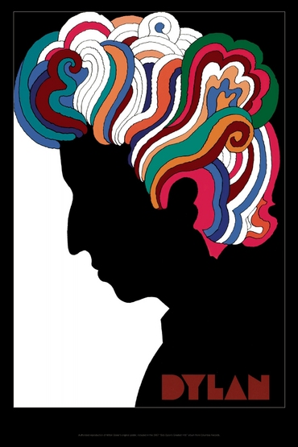
This is one of Glasers most famous pieces.
Description:
In this piece of there is a sillhouette of a man with wavy colourful hair. It has flat colours to portray both a sence of movement in the hair and the overall static nature of the figure.
Mood:
This piece displays a cheerful mood. We can tell that this is the case because of the colourful rhythmic nature of the hair that clearly creates a party atmophere.

Slide 4
Sensory:
You can see the use of cool colours in the picture. The lines in the picture are wavy which outline the shape of his hair. This creates subtle pleasent feeling presented by the piece.
Formal:
There is a theme of rhythm and movement in this picture. As well as a sence seriousness given by the dark black sillhouette in the background. This offers a nice contrast to the sence of freedom created by the hair.

Slide 5
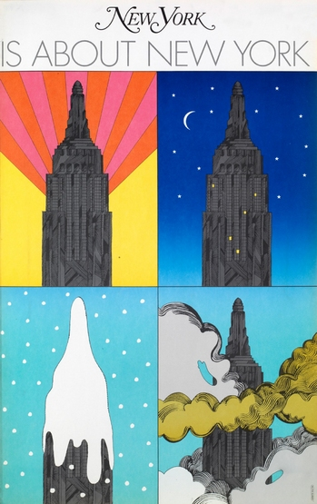
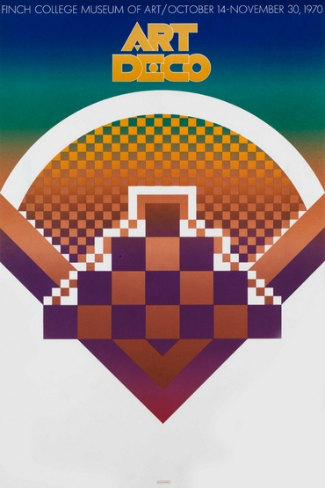
In both of these pieces we can see that the artist used repetition in order to convey his message.
In the image on the left the artist uses flat colors in order to create his illustration where as on the right he still uses a lot of flat colors he also uses a bit of blending.
Symmetry is used in both images and we can tell that this is stylistic feature which the artist likes to take advantage of.

Slide 6
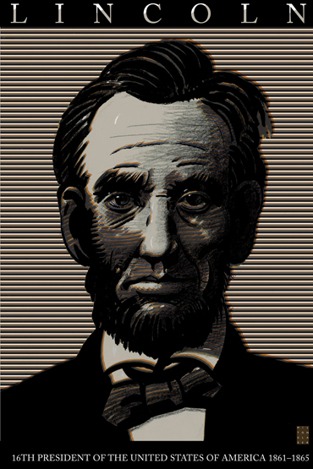
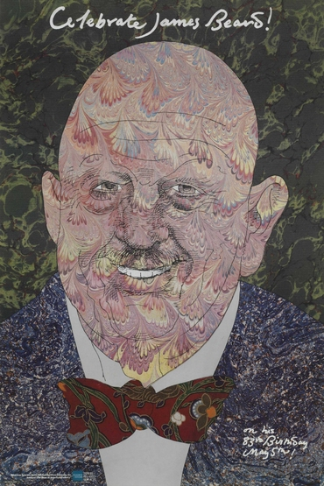
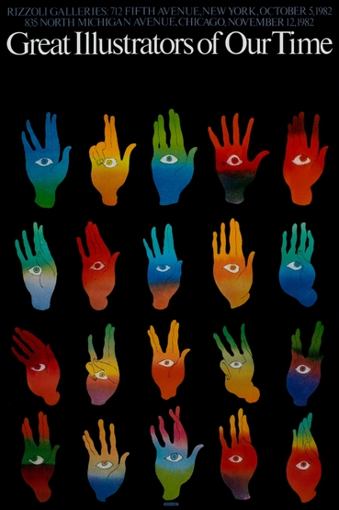
Both these pieces are portraits of individuals.
In the image on the left the typography is very professional and official this helps convey the serious nature of the presidential role where as we can see with in the portrait of James Beard he uses typography that is a lot more humanist in style create the sense that he is a lot more of a personality than a president.
We can see that the artist made quite a lot of use of pattern in both piece however the manner in which he uses it is very different in each. In the image on the left he uses straight uniform lines in order to symbolize the very important official role which he plays. In the other image however, we can see that the patterns he uses are a lot more playful and energetic to create an image of someone who's very bubbly. I think its very interesting to see this too very contrasting styles coming from the same artist.

Slide 7
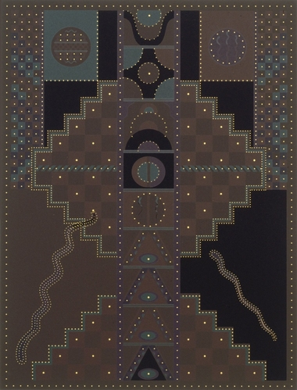
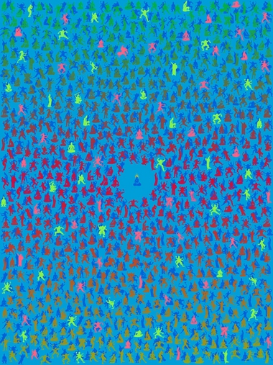
In these images you can again see the strong use of pattern and also I would argue symmetry.
In the image on the left the artists uses lots of dots and lines in order to create a very geometric composition.
However in the piece on the right he tries to create a sense of movement through the use of circles and people and this helps to create a composition that is much more organic.
The colors in the image on the left are very dark and these compliment the geometric nature of the peace
In the peace on the right the colors are much brighter and I think that this adds to the movement and organic nature of the piece.

Slide 8
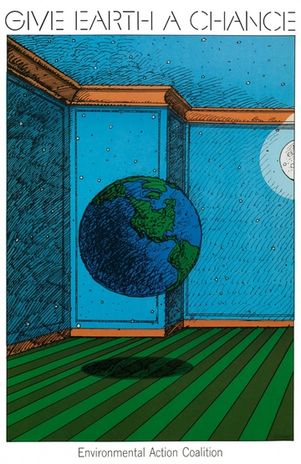
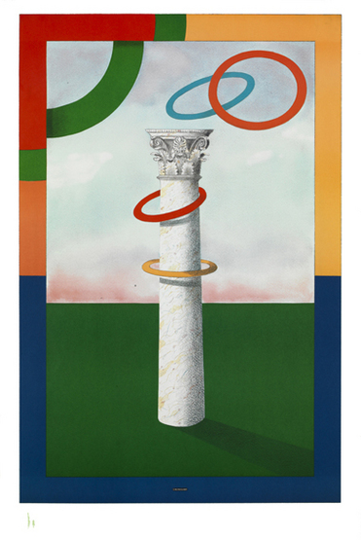
In both of these images there is a central object which is the clear focus of the images.
Each of these images use very flat colors which can make them very appealing to the eye and easy to look at.
On the left the artist uses leading lines in order to draw focus to the earth
However this is not the case with the image on the right and this is not great because there is nothing to hold my focus.

Slide 9
FIN

